Slide 1

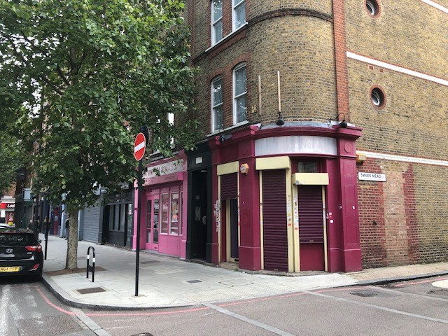
A1 RETAIL UNIT TO LET
TOWER BRIDGE ROAD, SE1
Tel: 07885 912 982
Insert an image here
BRIGHTON BUILDINGS
TOWER BRIDGE ROAD, LONDON SE1
APPROX. 400 SQ FT (37.2 SQM)
USE CLASS - A1
RENTAL - £13,000 PER ANNUM EXCLUSIVE

Slide 2
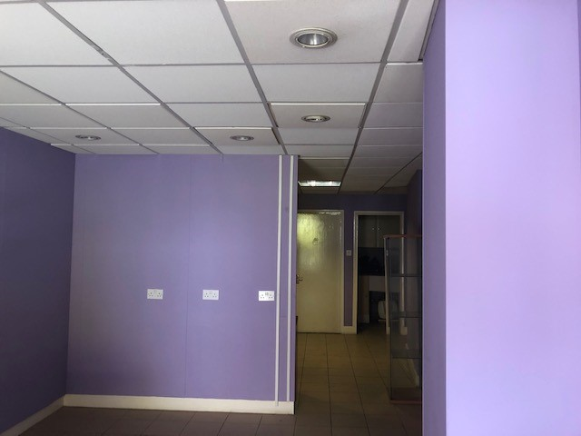
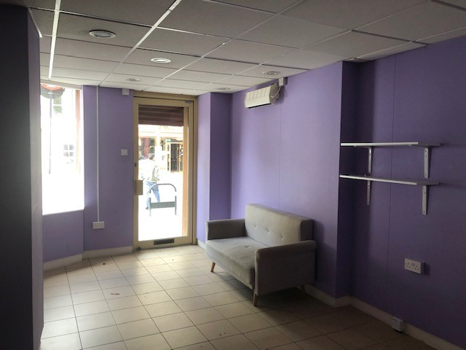
BRIGHTON BUILDINGS, TOWER BRIDGE ROAD, LONDON SE1.
Description
A self-contained ground floor retail unit forming part of similar units within a parade and located within a small high street made up of commercial retail and residential area. The property benefits from a return frontage with electric shutters, tea-point and single W.C. The existing use of the premises fall under A1 and the unit is available immediately.

Slide 3
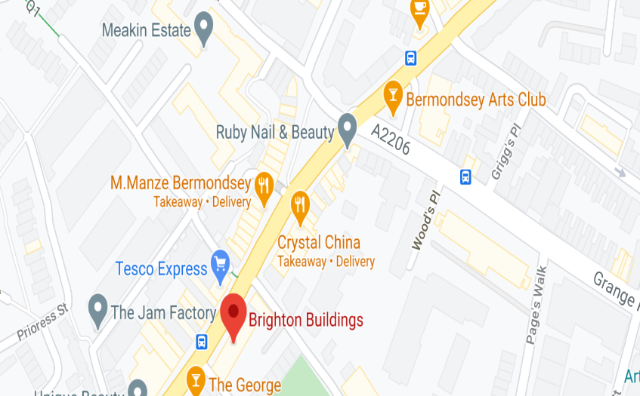
Tel: 07885 912 982
5 Risborough Street
Term
A new lease offered on terms by arrangement.
Business Rates
To be confirmed.
MAP
Specifications
Recessed spotlights
Suspended ceiling
Tiled floors
Electric security shutters
Electric heating
Tea-point
Single W.C
Service Charge
Re-charge of buildings insurance.
VAT
VAT is payable on the rent.
Location
Located within a parade of shops along Tower Bridge Road close to the junction with Swan Mead and within walking distance to the popular Bermondsey Street and the attractions of SE1. There are various bus routes serving the community to all central destinations.
EPC
Rating – E = 110
Rent
£13,000 per annum exclusive
Floor Area
Ground Floor 400 sq ft (37.2 sqm)
Further Details
Ian Lim
E: ian@limcommercial.com
www.limcommercial.com
Tel: 07885 912 982
MISREPRESENTATION ACT 1967
Important: These particulars have been prepared as agent for our clients and are intended as a convenient guide to supplement an inspection or survey. They do not constitute any part of an offer or contract and their accuracy is not guaranteed. They contain statements of opinion and in some instances we have relied on information provided by others. You should verify the particulars on your visit to the property and the particulars do not obviate the need for a full survey and all of the appropriate enquiries. Accordingly, there shall be no liability as a result of any error or omission in the particulars or any other information given.

